Slide 1

UNIVERSITY OF KALYANI
DEPARTMENT OF ENGINEERING AND TECHNOLOGICAL STUDIES
Topic: HUB PROTEIN IDENTIFICATION OF CORONAVIRUS DISEASE : A MACHINE LEARNING PRACTICE
SUBJECT : Presentation of Project Report
PRESENTED BY : Srutee Sen & Debasis Maji

Slide 2
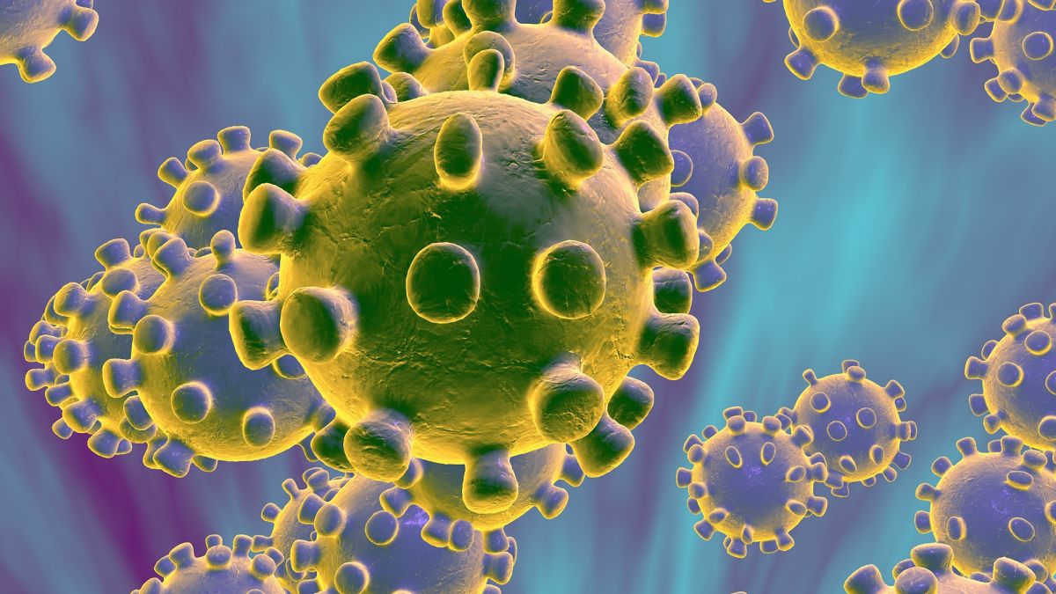
INDEX
Introduction
Motivation
Objective
Overview
Brief Idea
Comparison
Tech Requirements
Roadmap
Highlighted Some Work
Results
Real Life Aspect
Future Work
Conclusion

Slide 3

PROJECT TOPIC
HUB PROTEIN IDENTIFICATION OF CORONAVIRUS DISEASE :
A MACHINE LEARNING PRACTICE

Slide 4
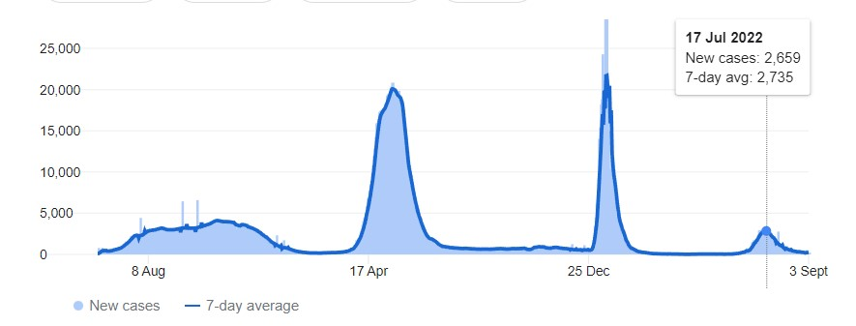
INTRODUCTION
COVID-19 has led to one of the most disruptive disasters in the current century
The health system and economy of a large number of countries have been impacted.
As per World Health Organization (WHO) data, there have been 60,5024781 confirmed cases of COVID-19, including 64,36153 deaths within 30th March 2023.
Prediction for the number of cases in a pandemic and implications for health care needs and resources have received a lot of attention in the scientific world.

Slide 5

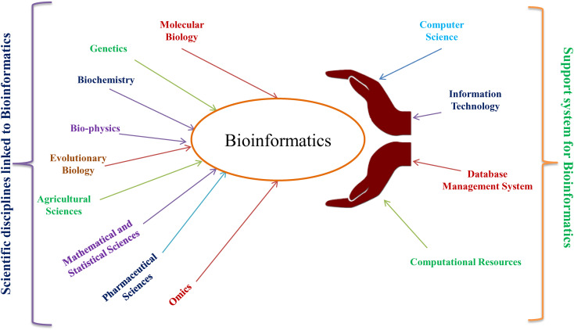
MOTIVATION
Bio-Informatics project is very helpful & benefitted the human society and Environment
Research based project of covid 19.
New and Updated research in this field. We used Graph analysis and Machine Learning in to get result.
Machine Learning (ML) are the most widely used techniques in this project.

Slide 6


OBJECTIVE
Identify key proteins that responsible for this disease.
Most significant protein of coronavirus disease that effect Human mostly.

Slide 7
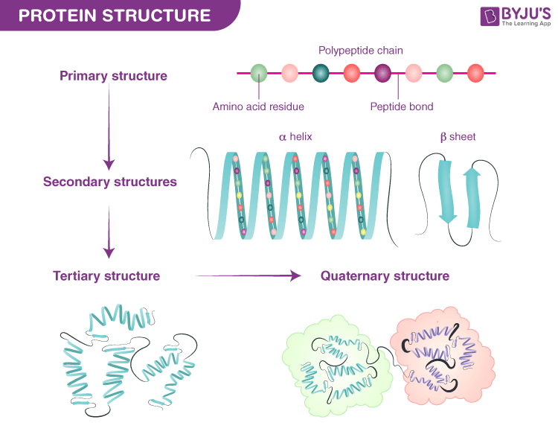
OVERVIEW
Nature of Human Protein and Viral Protein
Human proteins are produced by the host cells and are involved in various cellular processes
Human proteins include enzymes that catalyse biochemical reactions in the body.
Coronavirus has several structural proteins, including spike (S), envelope (E), membrane (M), and nucleocapsid (N) proteins.
The spike protein is a key component of the coronavirus that enables it to enter host.

Slide 8

OVERVIEW
Why Machine Learning
Complex Data Analysis
Feature Extraction
Supervised learning( Labelled Data)
Classification and Regression problem
To find Accuracy, Precession, Recall and F1 Score

Slide 9
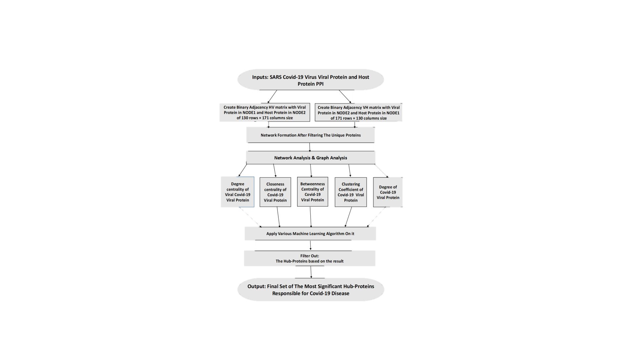
BRIEF IDEA

Slide 10

COMPARISON
One study that can be compared to this project is "Identification of Key Genes and Pathways in Coronavirus Disease 2019 Using Network Analysis" by Wang et al. (2020).
network analysis to identify key genes and pathways
Another study that can be compared to the project is "Identification of Potential Key Genes and Pathways in COVID-19 by Bioinformatics Analysis" by Li et al. (2020).
bioinformatics analysis to identify potential key genes and pathways and functional enrichment analysis

Slide 11


TECH REQUREMENT
Data resources: NCBI and the Coronavirus Data Portal.
Integrated development environment tools: We used Jupyter as a python IDE
Machine learning tools: Popular machine learning libraries include scikit-learn, TensorFlow, PyTorch, NumPy, Pandas and Keras.
Graph analysis tools: Popular graph analysis libraries include NetworkX, igraph, and Cytoscape.
Visualization tools: visualization libraries include Matplotlib, Seaborn, Plotly, and Bokeh.
Gene Ontology Analysis tool: A graphical tool for gene enrichment analysis is Shiny GO Tool

Slide 12
ROADMAP
Phase 1
Phase 2
Phase 3

Slide 13

ROADMAP
Phase 1 : Data Collection
Study & Research
Data Collection
Literature Survey

Slide 14
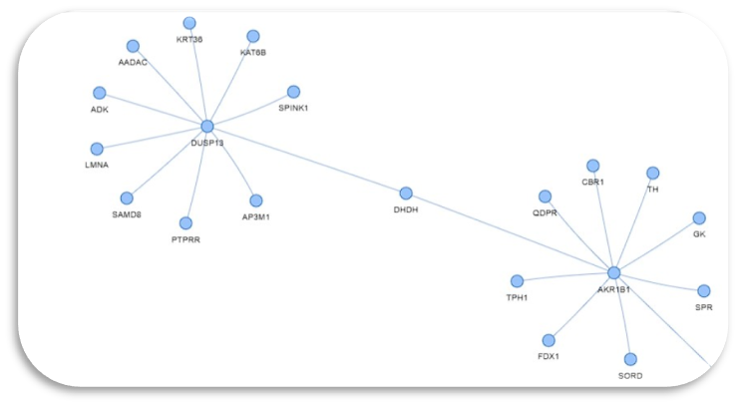
ROADMAP
Data pre-processing
Create Adjacency Matrix
Protein Protein Interaction
Discussion & Comparison
Graph Analysis
Apply ML Algorithm
Phase 2 : Experiment

Slide 15
ROADMAP
Phase 3 : Biological Analysis and Result
Gene ontology Analysis
Hub Protein Identification
Final Outcome

Slide 16
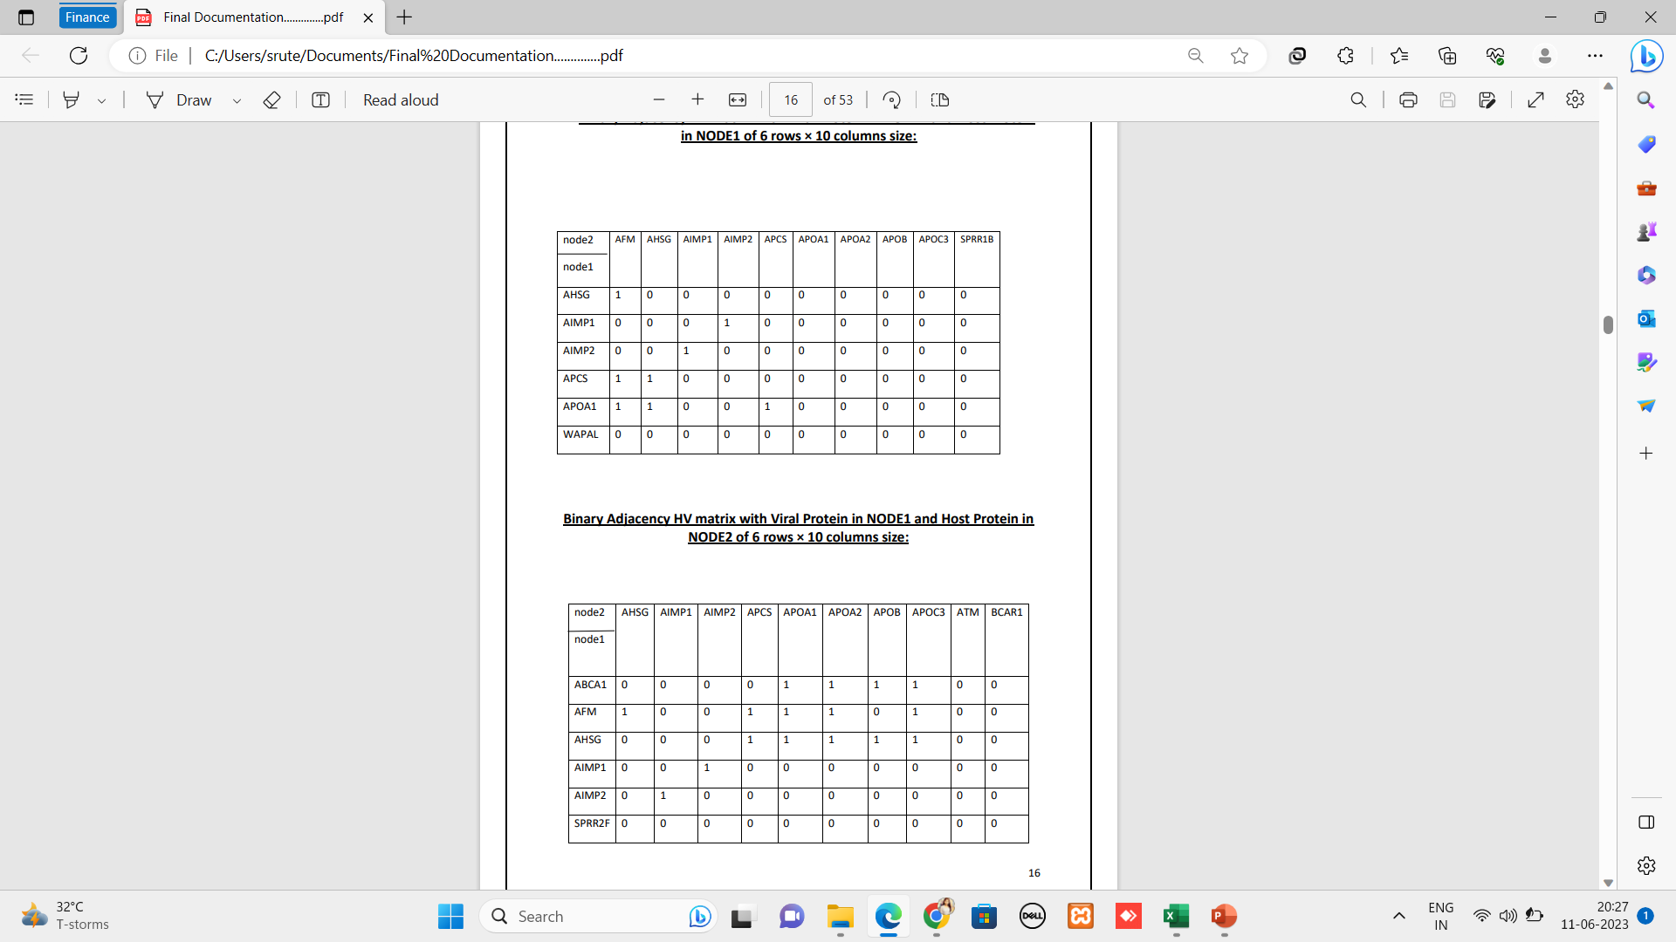
Highlighted Work
Adjacency Matrix: Binary Adjacency VH matrix with Viral Protein in and Host Protein

Slide 17
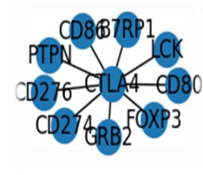
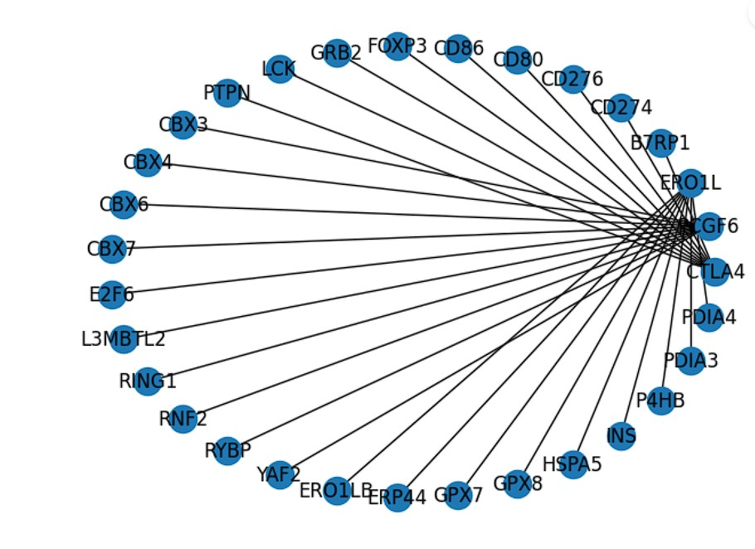
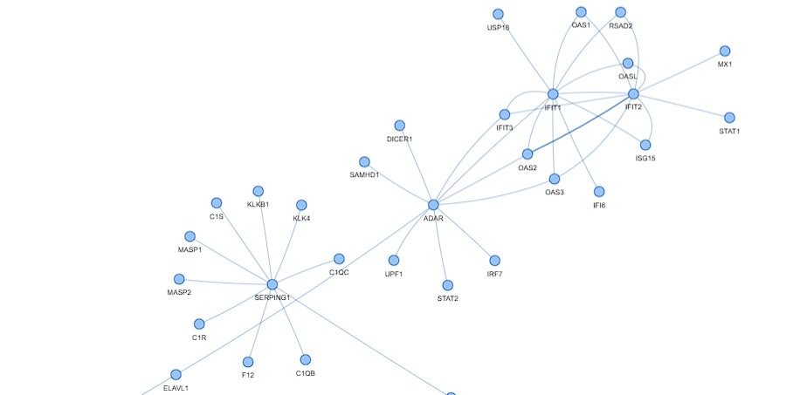
Highlighted Work
Graph Analysis

Slide 18
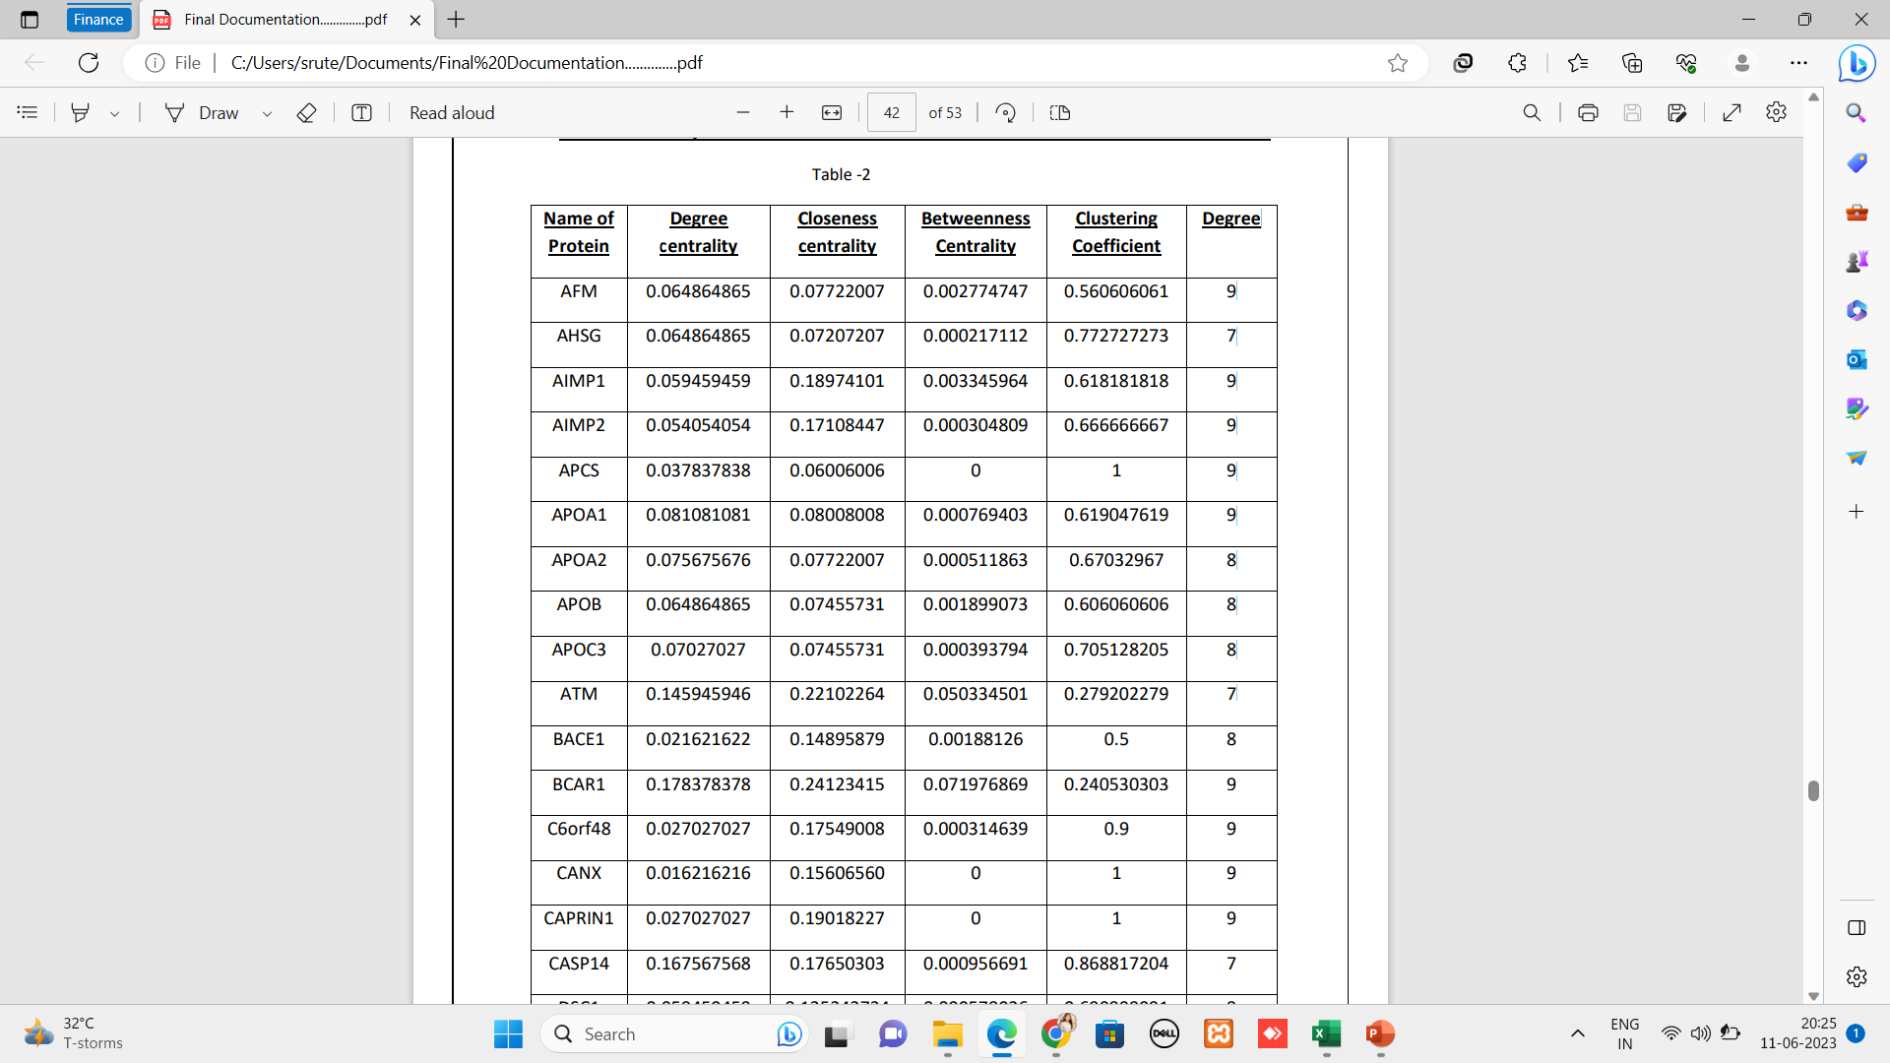
Results

Slide 19
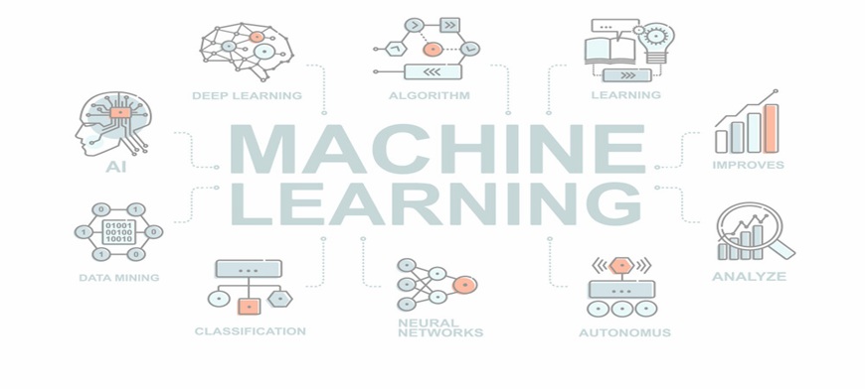
Machine Learning Result
SVM with RBF kernel
Accuracy: 62.9629629626 %
F1 score: 48.6531986531 %
SVM using Polynomial kernel
Accuracy: 42.857142854 %
Decision tree
Accuracy: 63.636366363 %
recall: 62.96296296 %
precision: 62.96296296 %
F1 score: 25.7142828571 %
recall: 25.0 %
precision: 42.857142854 %
F1 score: 47.222222214 %
recall: 50.0 %
precision: 63.636336363 %
K Means
Accuracy: 81.880681%
Precision: 60.32585%
Recall: 50.0 %
F1 score: 47.22222 %

Slide 20
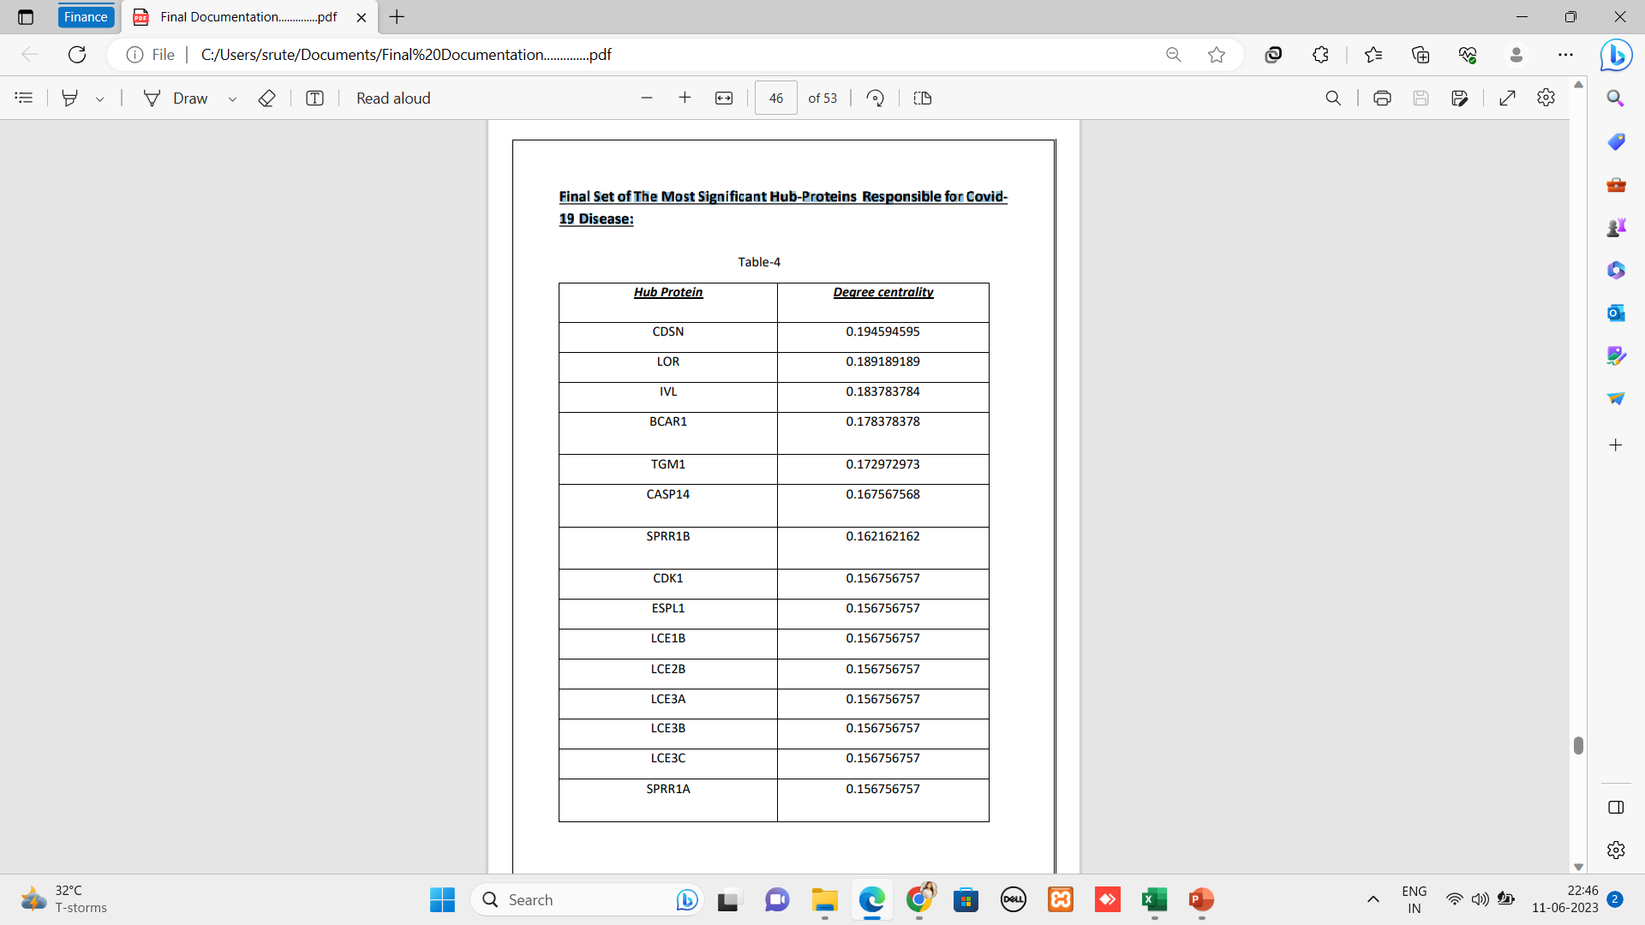
Final Set of The Most Significant Hub-Proteins Responsible for Covid19 Disease:

Slide 21
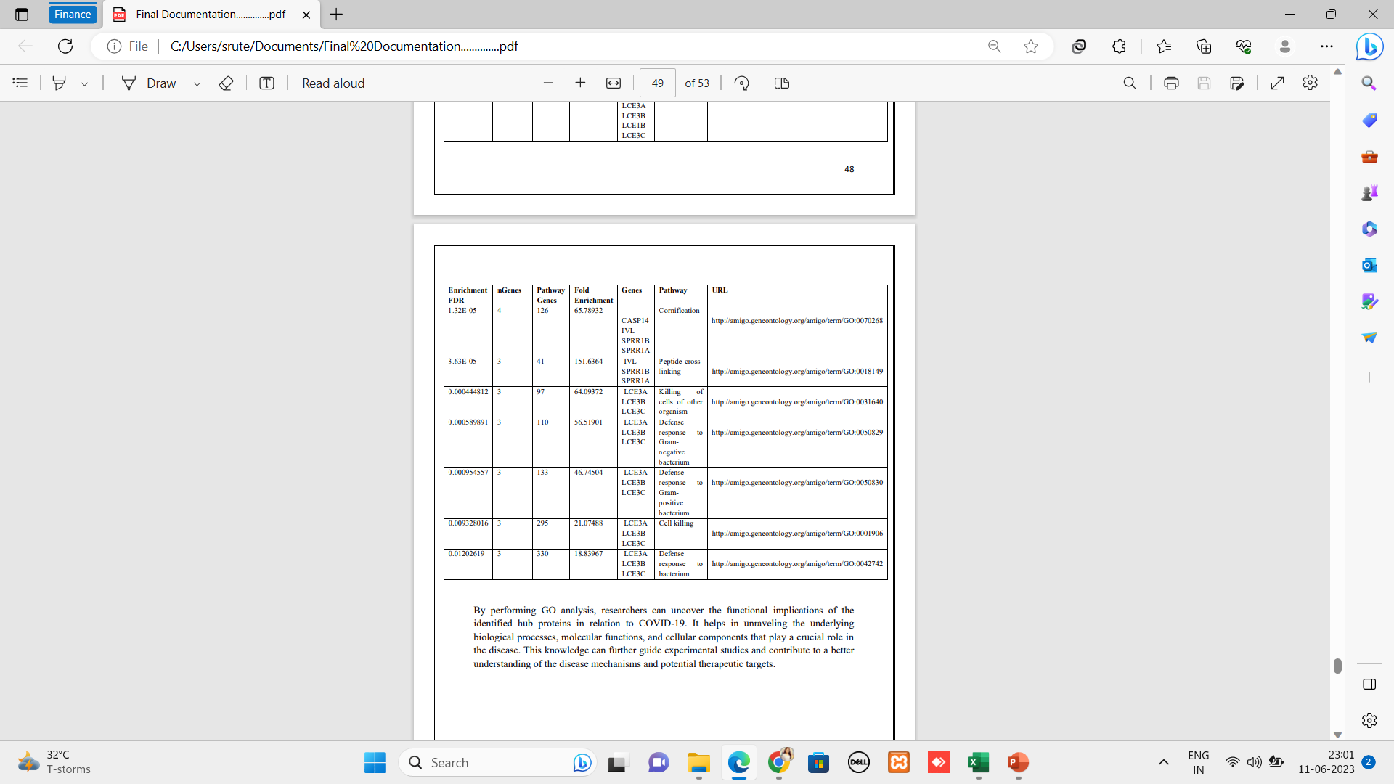
GENE ONTOLOGY ANALYSIS
Gene Ontology (GO) analysis is a widely used method in bioinformatics that helps understand the functional properties and biological roles of genes or proteins.

Slide 22
Real Life Aspect
This project is very helpful & benefitted the human society and Environment. By this project we are predict the Coronavirus disease of different human body.
After complete this project it will be easy to drug target of Coronavirus disease.
ML methods could improve the accuracy of covid19 susceptibility, recurrence, and survival prediction. The accuracy of covid19 prediction outcomes can be significantly improved by 15%–20% as compared to the traditional methods, with the application of ML techniques.

Slide 23


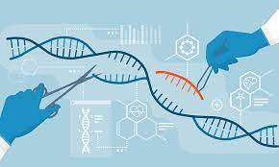
FUTURE WORK
Drug Target interaction
Analysis genetic variability
Validation of predicted target

Slide 24

CONCLUSION
The COVID-19 pandemic has deeply marked the year 2020 - 2021 and has made the researchers community in different fields react.
We will identify hub protein of corona virus dieses that will help in medical sector that the person is effected or not.
By this project drug target will also be more easy.

Slide 25
REFERENCE
• IET Syst. Biol., 2019, Vol. 13 Iss. 5, pp. 234-242 SN Computer Science (2022) 3:286
• Lai C-C, Shih T-P, Ko W-C, Tang H-J, Hsueh P-R. Severe acute respiratory syndrome coronavirus 2 (sars-cov-2) and coronavirus disease-2019 (covid-19): The epidemic and the challenges. Int J Antimicrob Agents. 2020;55(3): 105924.
• Gitanjali R Shinde, Asmita B Kalamkar, Parikshit N Mahalle, Nilanjan Dey, Jyotismita Chaki, and Aboul Ella Hassanien. Forecasting models for coronavirus disease (covid-19): a survey of the state-of-the-art. SN Computer Science, 1(4):1–15, 2020.
• BioMedical Journal 43(2020) 438-450) By Lopamudra Dey, Sanjay Chakraborty, Anirban Mukhopadhyay
• RESEARCH ARTICLE Identification of host genomic biomarkers from multiple transcriptomics datasets for diagnosis and therapies of SARS-CoV-2 infections
• https://doi.org/10.1007/s42979-022-01184-z
• https://youtube.com/playlist?list=PLKuX62ahaHyKnj-1AE9OnDJk_CC3yR_Bb
• https://www.who.int/emergencies/diseases/novel-coronavirus-2019
• https://www.ncbi.nlm.nih.gov/
• http://geneontology.org/
• https://string-db.org/cgi/input?sessionId=b76w6eRZSZ0v&input_page_show_search=on
• https://drive.google.com/drive/folders/1TWDZFai4l4a7xpQe8ov7Wn9yI7nRT5NW

Slide 26

THANKING
We are very grateful to our guiders Dr. Nabin Ghoshal & Mr. Arup Mallick who are always guide to complete this project .

Slide 27
THANK YOU

Slide 28
THE END

